Slide 1
Identifying Nashville’s Popular Pythonistas with NetworkX
November 16, 2017
Stephen Bailey

Slide 2

Notes:
Networking: new to town. You want to meet people. You decide to go to a MeetUp. But which one? You could go to a big one on a specific topic. Or, cine you’re new to town, you might want to go where ots of people are.
Who?
Which groups?

Slide 3
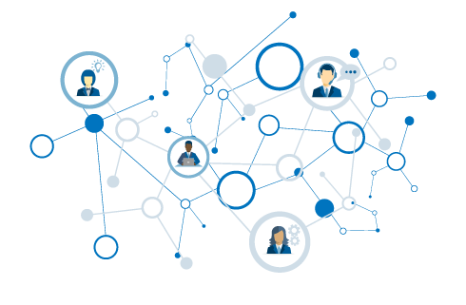
Popular Pythonistas
What is a network?
Using graphs
Ranking MeetUp groups
Ranking MeetUp people

Slide 4
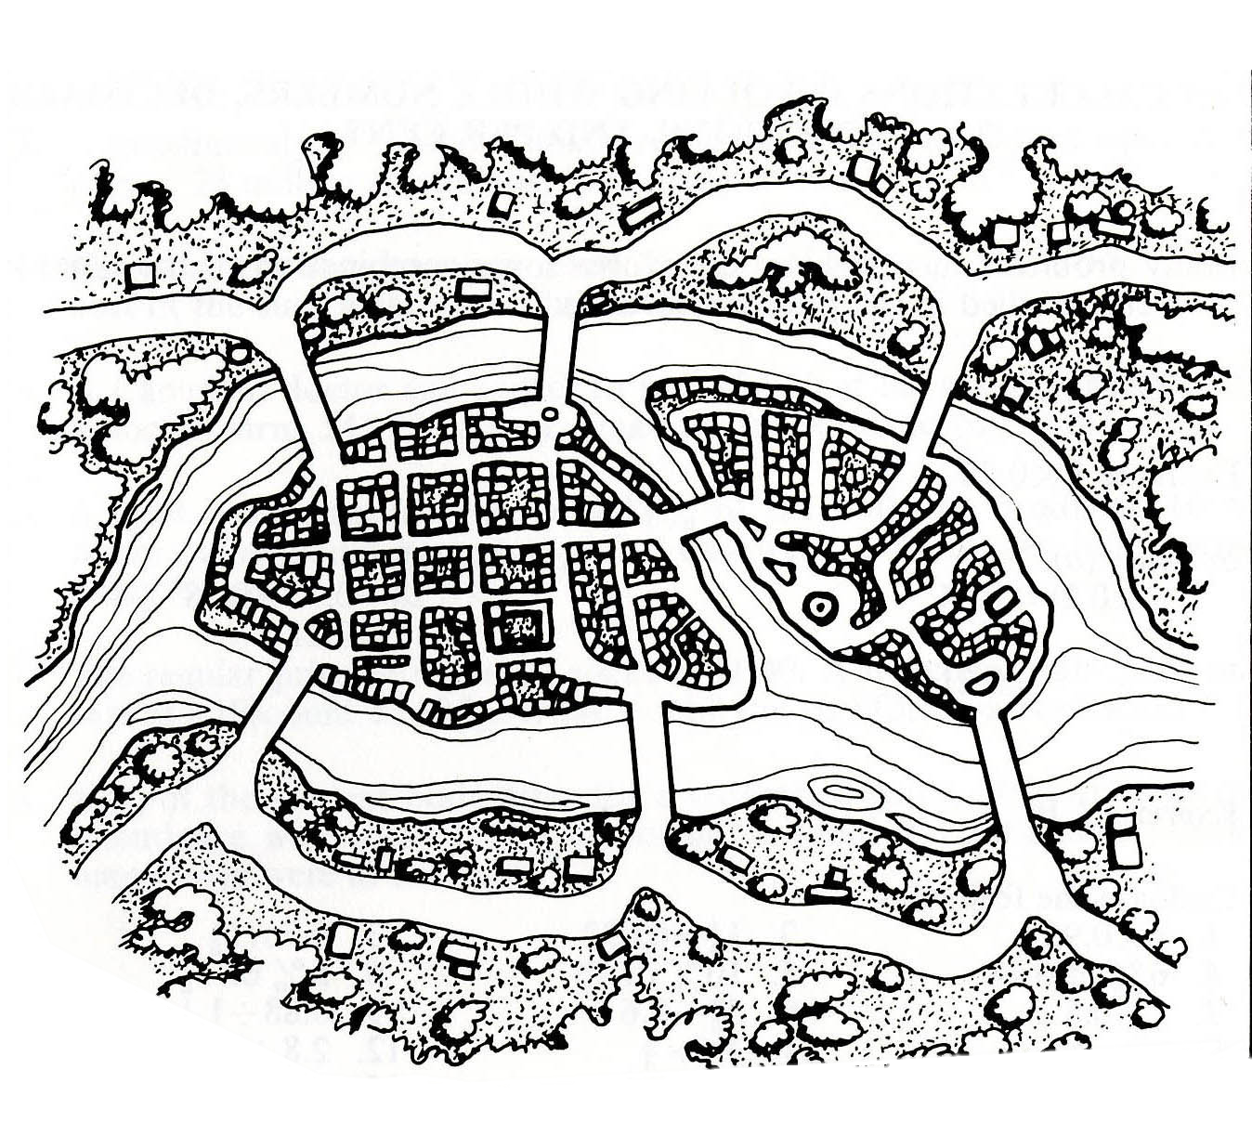
Can you traverse every bridge just once?
2
1
3
4
5
6
7

Slide 5
2
1
3
4
5
6
7

Slide 6
A
2
1
3
C
B
4
5
6
7
D

Slide 7
A
2
1
3
C
B
4
5
6
7
D

Slide 8
Graph
A
Node
B has the most connections
B
C
Edge
D
A & D are on the “outside” – they are not connected to each other
Notes:
Without knowing anything about this system, what is one thing you might say?
B seems to be the most “important” place – has the most connections.
B and C are seem to be more central to the graph – A and D are both on the edges

Slide 9
1
1
To travel into AND out of a node, requires 2 steps (or 4 or 6…).
Therefore… either:
All nodes are even.
Exactly two nodes are odd.
2
2
1
3
2
Notes:
Without knowing anything about this system, what is one thing you might say?
B seems to be the most “important” place – has the most connections.
B and C are seem to be more central to the graph – A and D are both on the edges

Slide 10
Four nodes with odd number of edges!
3
5
3
3
Notes:
Without knowing anything about this system, what is one thing you might say?
B seems to be the most “important” place – has the most connections.
B and C are seem to be more central to the graph – A and D are both on the edges

Slide 11
That’s the ticket…
3
4
3
2
Notes:
Without knowing anything about this system, what is one thing you might say?
B seems to be the most “important” place – has the most connections.
B and C are seem to be more central to the graph – A and D are both on the edges

Slide 12
Graphs
Useful for understanding relationships.
Describe structure of networks.

Slide 13
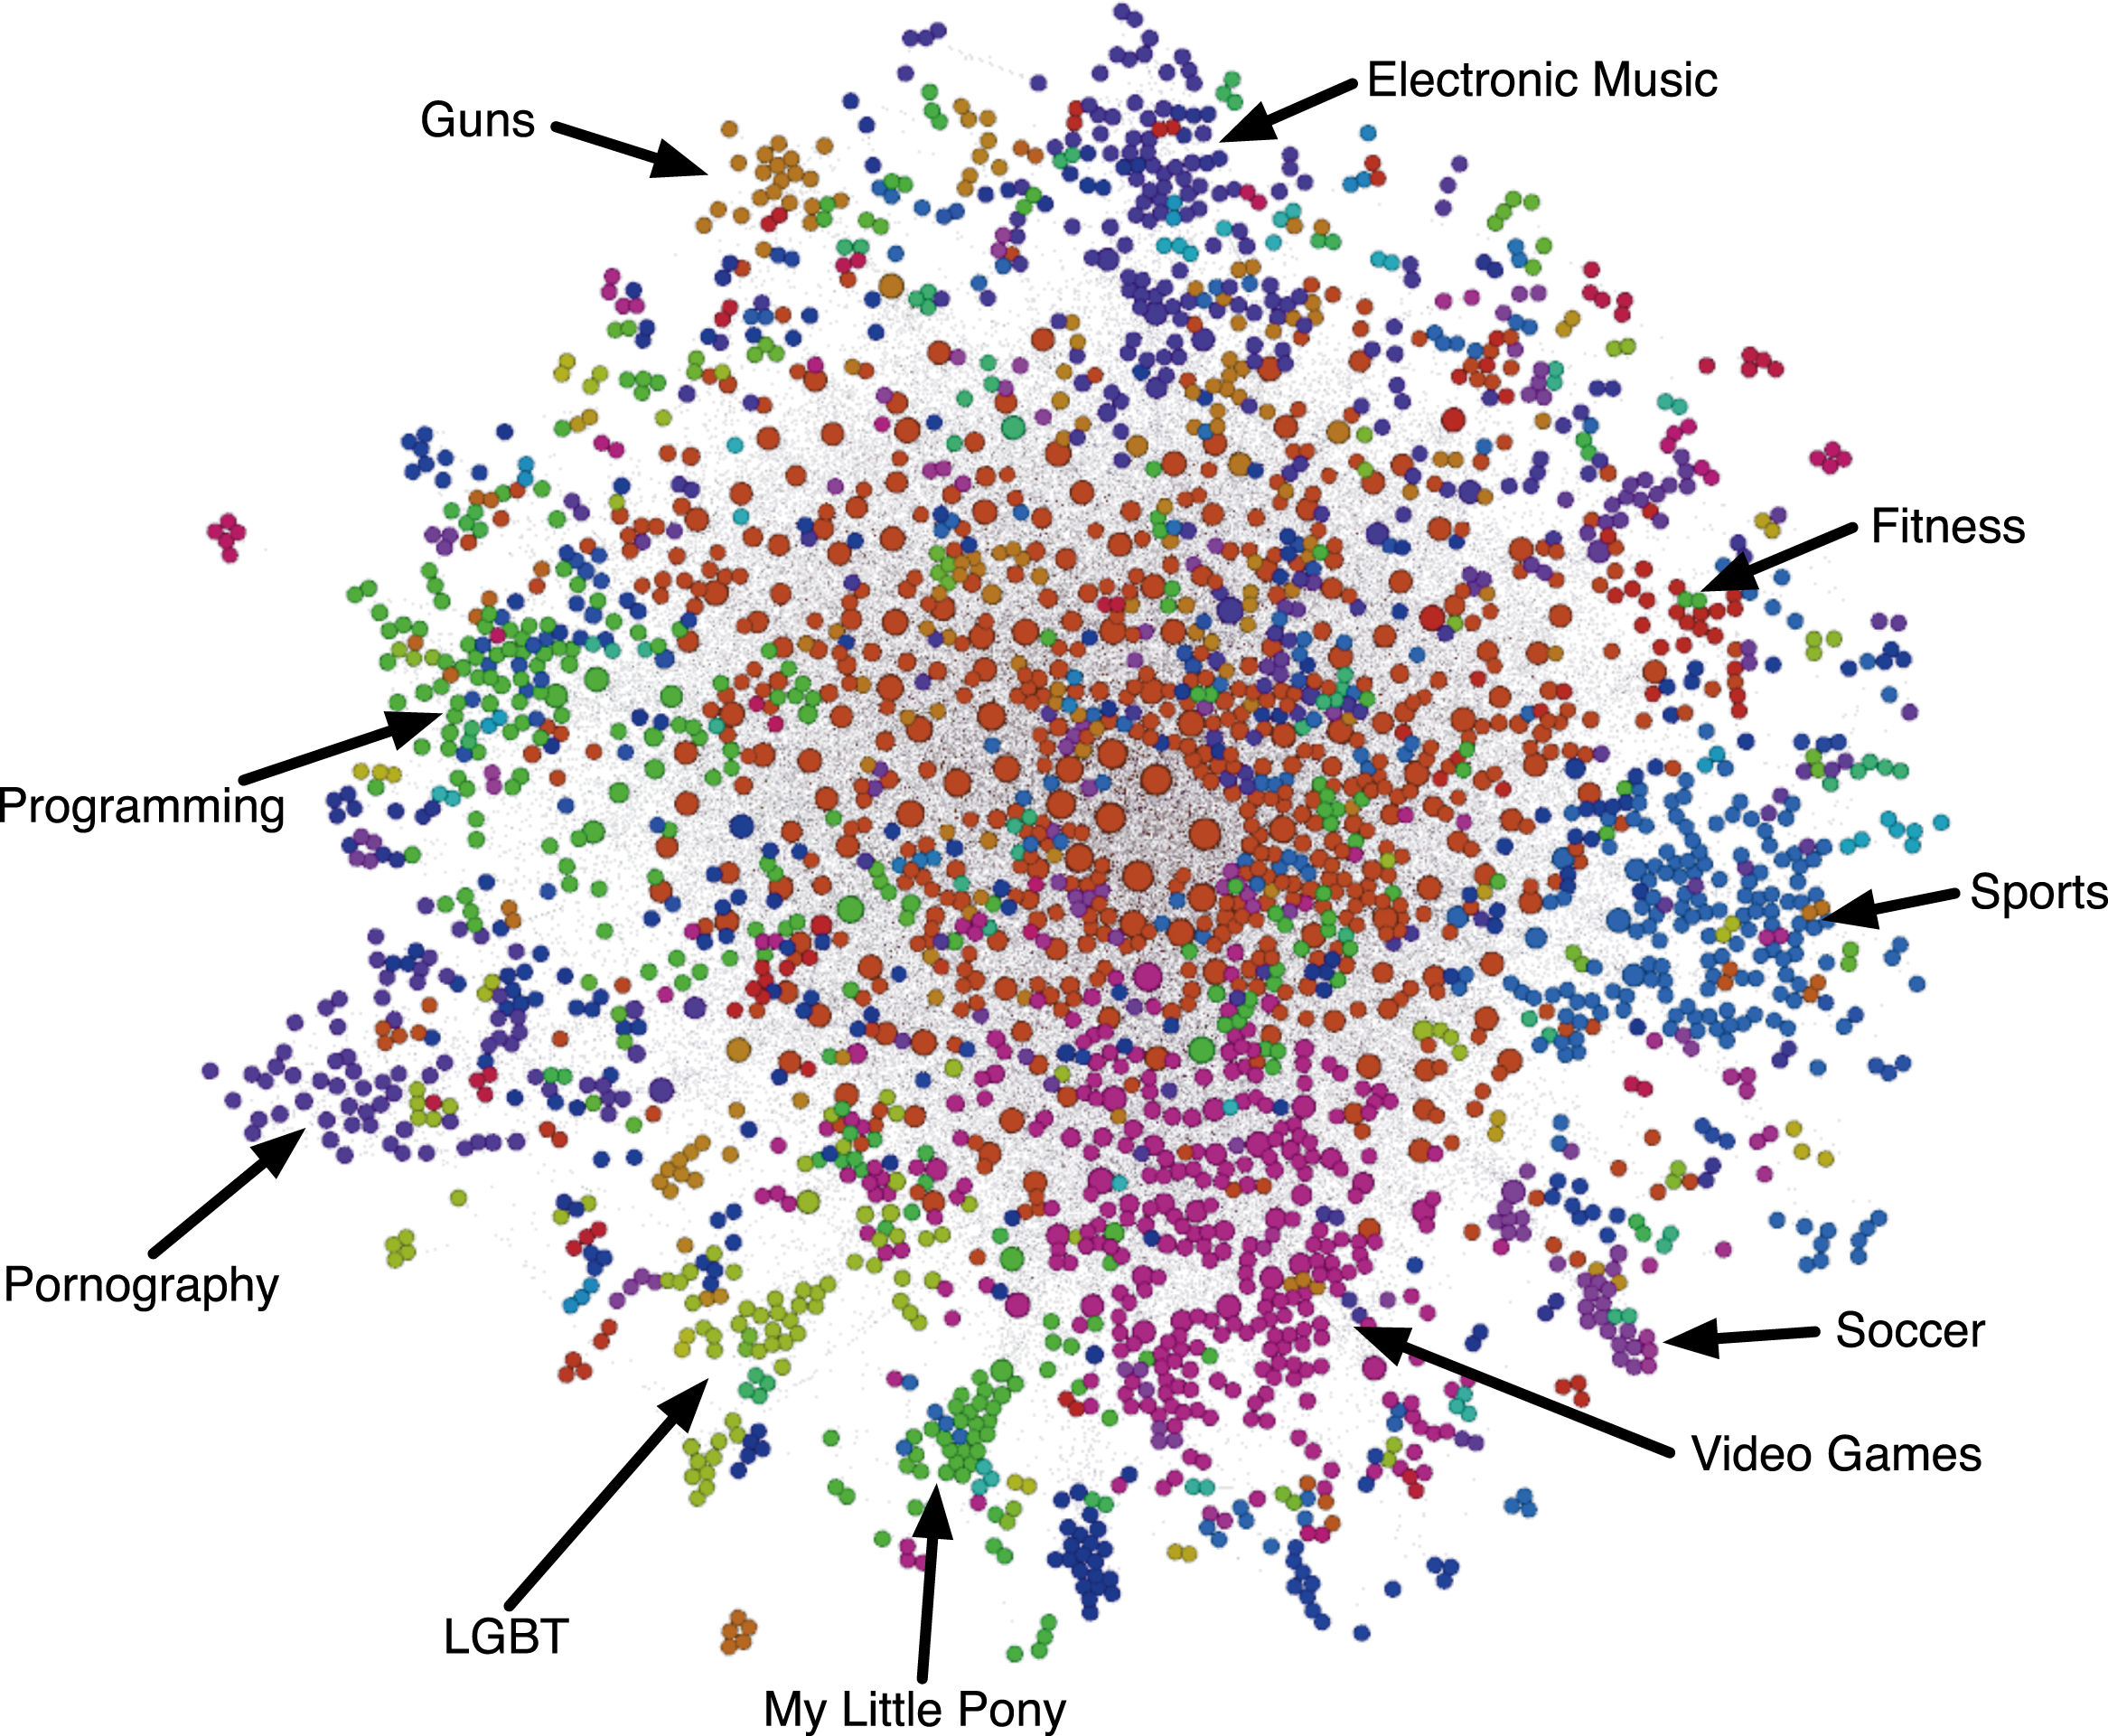
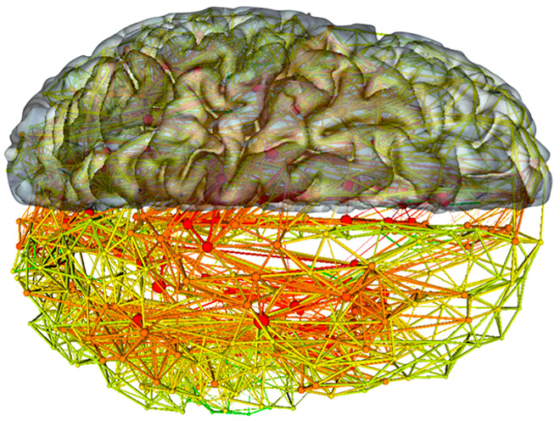
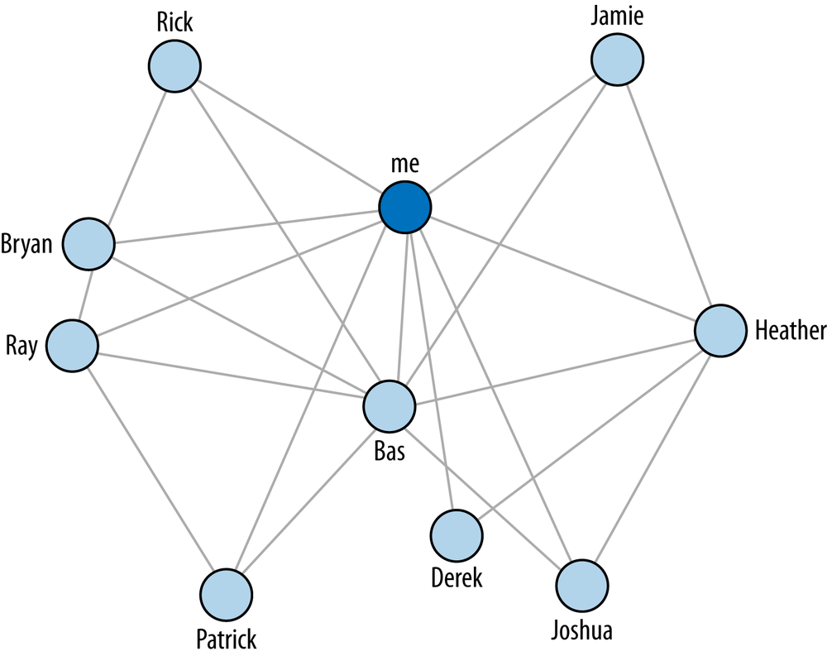
Notes:
Without knowing anything about this system, what is one thing you might say?
B seems to be the most “important” place – has the most connections.
B and C are seem to be more central to the graph – A and D are both on the edges

Slide 14
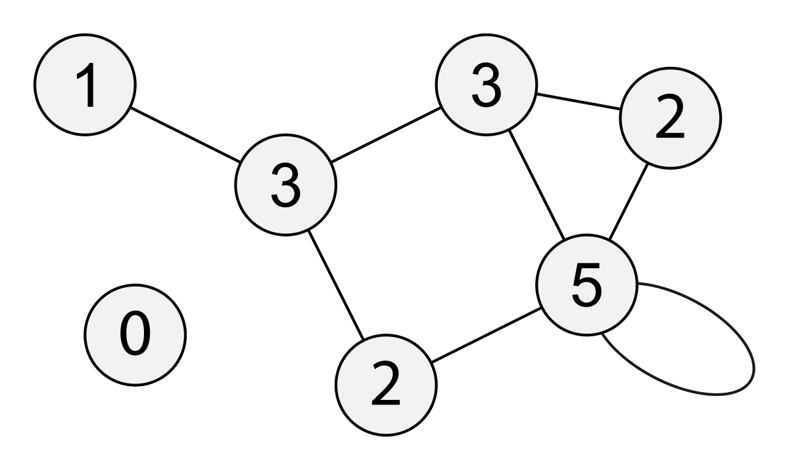
Degree
Path Length
Notes:
Path length – average

Slide 15
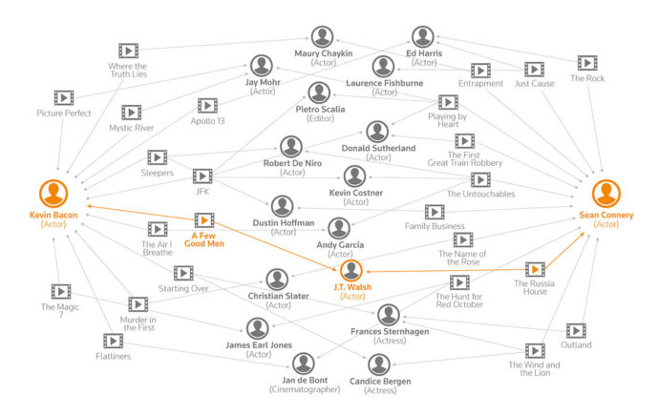

Slide 16
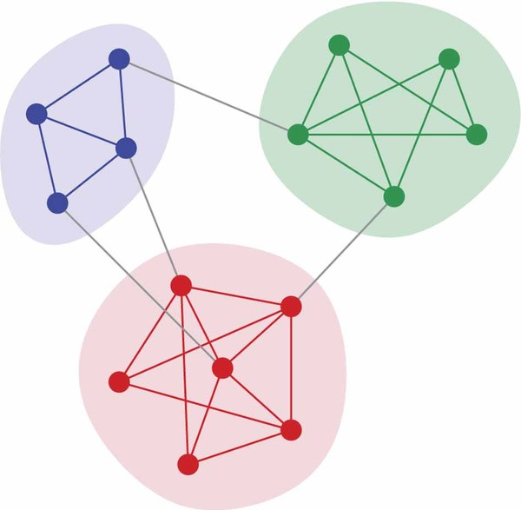
Clustering
Communities

Slide 17
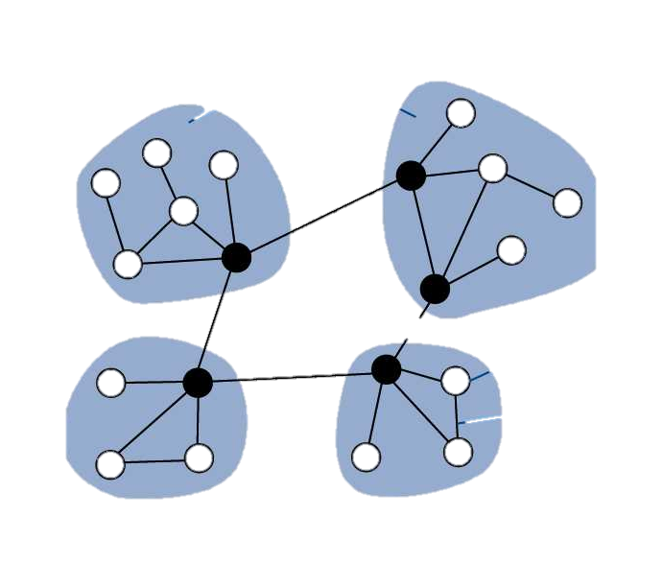
Hubs

Slide 18
Identifying a network problem
Good way to make sense of multivariate data
Centrality
Influence
Mapping
Recommendations

Slide 19
The MeetUp Data
Used MeetUp API to get the following information:
All groups within 25 miles of Nashville.
All members of those groups.
All events for each group and who RSVPed yes.
(On Github)

Slide 20
Bipartite Graphs

